Slide 1
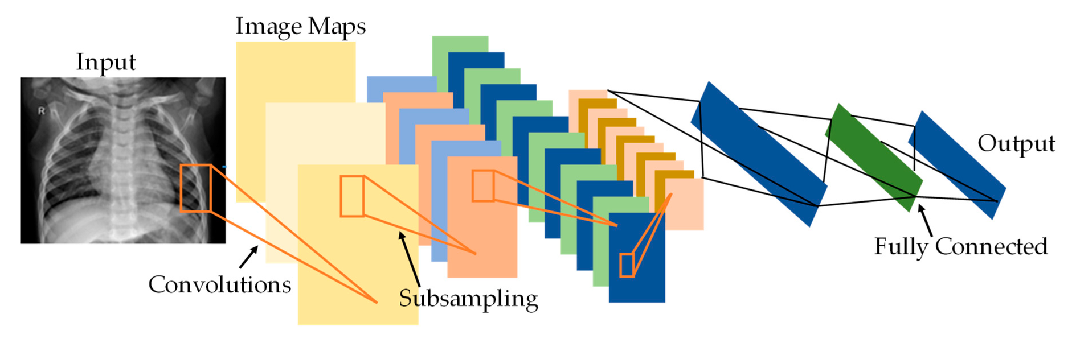
Minor Project
DETECTING COVID-19 FROM X-RAY USING CONVOLUTIONAL NEURAL NETWORK

Slide 2
Introduction:
A Convolutional Neural Network (ConvNet/CNN) is a Deep Learning algorithm which can take in an input image, assign importance to various aspects/objects in the image and be able to differentiate one from the other.
The pre-processing required in a ConvNet is much lower as compared to other classification algorithms.

Slide 3

The architecture of CNN consists of two blocks:
The initial block establishes the uniqueness of this sort of neural network by acting as a feature extractor. It achieves this by using convolution filtering techniques to perform template matching. The first layer uses many convolution kernels to filter the picture and provide "feature maps,". The output of the first block and the input of the second.
The second block is not unique to CNNs; in fact, it appears at the conclusion of all categorization neural networks. To return a new vector to the output, the input vector values are converted. This last vector has the same number of entries as classes.

Slide 4
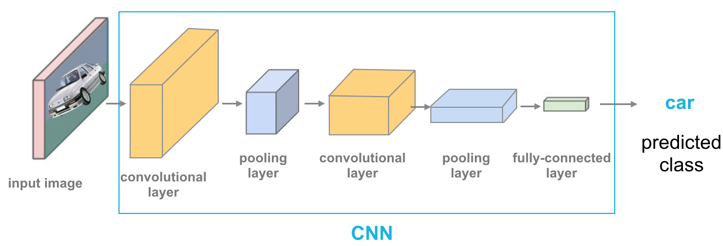
Layers:
There are four types of layers for a convolutional neural network:
Convolutional layer,
Pooling layer,
ReLU correction layer and
Fully-connected layer.

Slide 5
Convolutional Layer
This is the initial layer that extracts the different characteristics from the input photos. The convolution mathematical operation is done between the input picture and a filter of a certain size MxM in this layer. The dot product between the filter and the sections of the input picture with regard to the size of the filter is taken by sliding the filter across the input image (MxM).

Slide 6
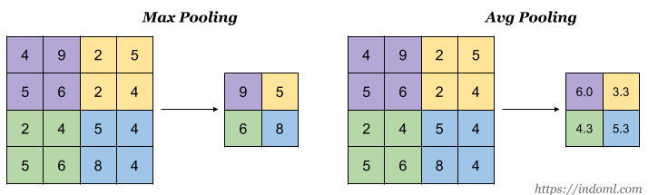
Pooling Layer:
This layer's major goal is to lower the size of the convolved feature map in order to reduce computational expenses. This is accomplished by reducing the connections between layers and operating independently on each feature map

Slide 7
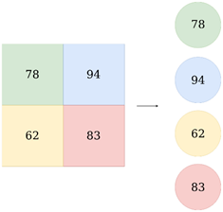
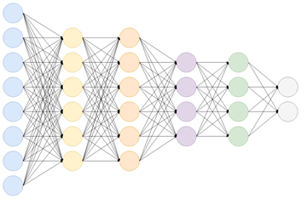
Fully Connected Network (FC)
The Fully Connected (FC) layer connects the neurons between two layers by combining the weights and biases with the neurons. These layers are often placed before the output layer and make up the final few levels of a CNN Architecture.
The output from the final Pooling or Convolutional Layer, which is flattened and then fed into the fully connected layer, is the input to the fully connected layer.

Slide 8
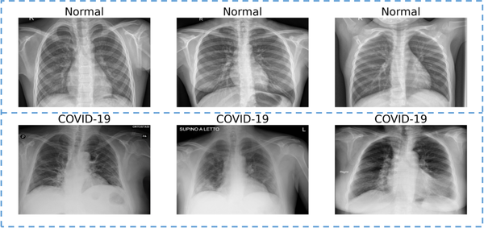
Objective:
The COVID-19 epidemic continues to have a terrible impact on the worldwide population's health and well-being. Successful screening of infected individuals is a critical step in the fight against COVID-19, with radiological imaging employing chest radiography being one of the primary screening modalities.
We will train and test our model to analyze the images as COVID or normal. The accuracy metrics are used to validate the classification of the model.

Slide 9
Literature Review
Researchers have used deep learning algorithms to examine chest X-ray pictures in order to detect COVID-19 in recent months. To extract better characteristics, the pictures are first pre-processed with the CNN method.
[1] On chest CT scans, a DenseNet201-based deep transfer learning model was presented to identify patients as COVID-19 infected or non-infected.
[2] Proposed a Deep model for early identification of COVID-19 patients using X-ray images with 98.08 percent and 87.02 percent accuracy for binary and multi-classes, respectively.
[3] used ResNet-34 with an accuracy of 98.33%. They used the effectiveness of eight pre-trained Convolutional Neural Network (CNN) models such as AlexNet, VGG-16, GoogleNet, MobileNet-V2, SqueezeNet, ResNet-34, ResNet-50 and Inception-V3 for classification of COVID-19 from normal cases

Slide 10
Why CNN?
Three important types of neural networks that form the basis for most pre-trained models in deep learning:
Artificial Neural Networks (ANN)
Convolution Neural Networks (CNN)
Recurrent Neural Networks (RNN)
Let's discuss about them.

Slide 11
Artificial Neural Network (ANN)
A single perceptron (or neuron) can be imagined as a Logistic Regression. An artificial Neural Network, or ANN, is a group of multiple perceptrons/ neurons at each layer. ANN is also known as a Feed-Forward Neural network because inputs are processed only in the forward direction.
ANN can be used to solve problems related to:
Tabular data
Image data
Text data
Challenges with Artificial Neural Network (ANN)
While solving an image classification problem using ANN, the first step is to convert a 2-dimensional image into a 1-dimensional vector prior to training the model. This has two drawbacks:
The number of trainable parameters increases drastically with an increase in the size of the image.
ANN loses the spatial features of an image. Spatial features refer to the arrangement of the pixels in an image.

Slide 12
Recurrent Neural Network (RNN)
A recurrent neural network (RNN) is a class of artificial neural networks where connections between nodes form a directed or undirected graph along a temporal sequence.
We can use recurrent neural networks to solve the problems related to:
Time Series data
Text data
Audio data
Challenges with Recurrent Neural Networks (RNN)
Deep RNNs (RNNs with a large number of time steps) also suffer from the vanishing and exploding gradient problem which is a common problem in all the different types of neural networks.

Slide 13
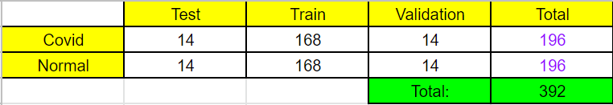
Dataset
For our project, we used a dataset of 392 images of chest x-rays. Out of them, we used 7% for our test and validation dataset and 85% for our train dataset.

Slide 14
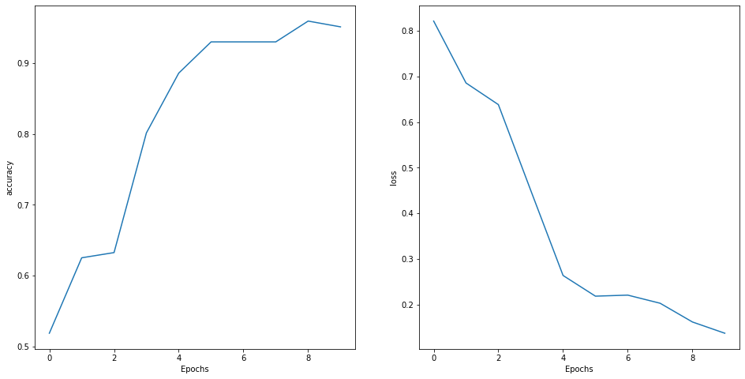
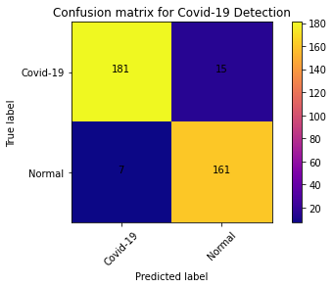
Output
Epochs vs Accuracy
Epochs vs Loss

Slide 15
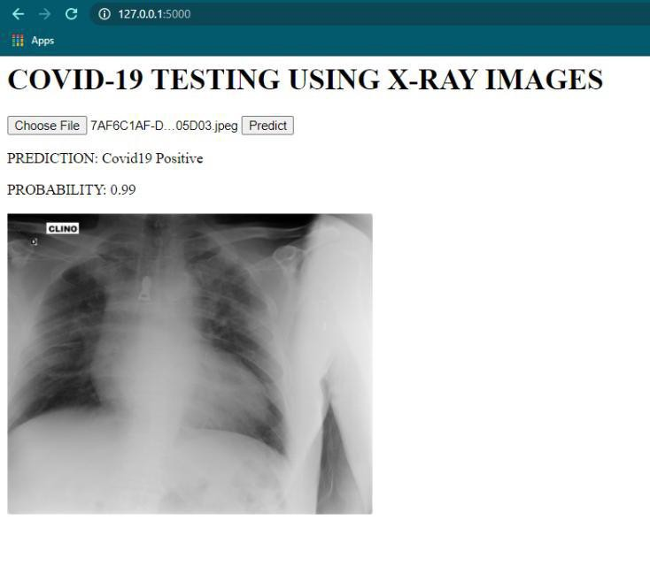
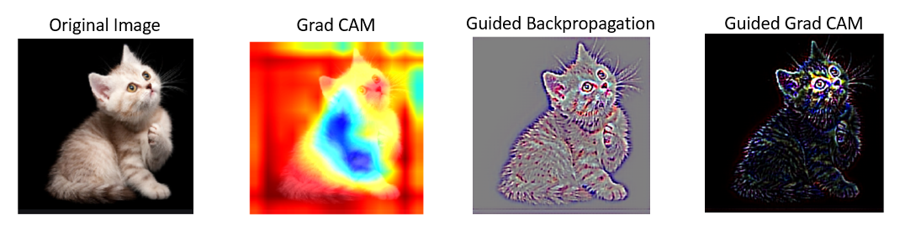
Future Scope
Implementing Grad-CAM: on the dataset.
Adding a user interface to predict the dataset instantly.
Adding more variety of diseases that can be predicted using X-rays.

